Slide 1
The Benefits of Pasteurised Fruit Juice: A Focus on MicroThermics
Pasteurised fruit juice

Slide 2
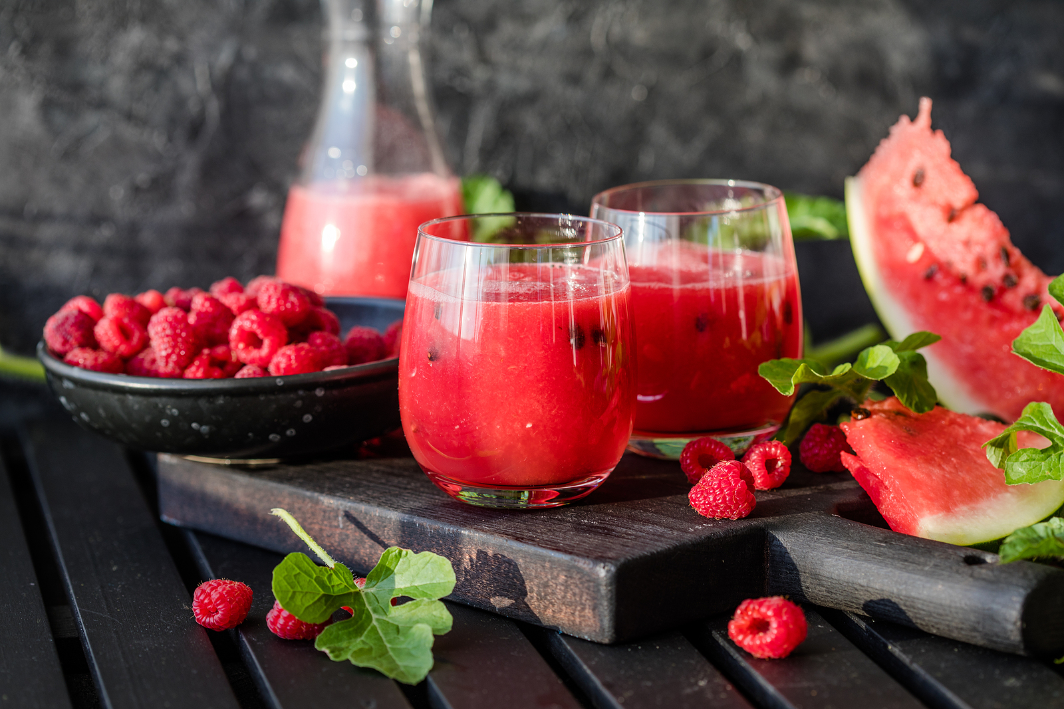
Introduction
Pasteurized fruit juice has become a staple in households worldwide, offering consumers a safe and delicious way to enjoy the natural flavors of fruits. The process of pasteurization ensures that the juice is free from harmful bacteria, making it a healthier choice for people of all ages. One company that stands out in this field is MicroThermics, a leading provider of pasteurization and aseptic processing equipment. Let's delve into the advantages of pasteurised fruit juice and how MicroThermics is revolutionizing this industry.

Slide 3
Ensuring Safety and Quality
Pasteurization is a heat treatment process that eliminates pathogenic microorganisms in food and beverages. For fruit juices, this means heating the juice to a specific temperature for a set period, effectively killing bacteria without compromising the juice's flavor, color, or nutritional value. This process is critical in preventing foodborne illnesses and extending the shelf life of the juice.
MicroThermics excels in this area by providing advanced pasteurization equipment designed to maintain the highest safety and quality standards. Their systems are engineered to ensure precise temperature control and uniform heating, resulting in consistently safe and delicious fruit juice products.

Slide 4
Preserving Nutritional Value
One of the main concerns with pasteurization is the potential loss of nutrients. However, with MicroThermics' state-of-the-art equipment, this is no longer an issue. Their technology is designed to preserve the essential vitamins and minerals found in fresh fruit juice. By carefully controlling the pasteurization process, MicroThermics ensures that consumers receive a product that is both safe and nutritious.

Slide 5
Extending Shelf Life
Another significant benefit of pasteurized fruit juice is its extended shelf life. Unpasteurized juices can spoil quickly due to bacterial growth, but pasteurization significantly reduces this risk. MicroThermics' innovative equipment helps juice producers achieve a longer shelf life without the need for preservatives, allowing consumers to enjoy fresh-tasting juice for longer periods.

Slide 6
Supporting Sustainability
MicroThermics is committed to sustainability, offering energy-efficient pasteurization solutions that minimize environmental impact. Their equipment is designed to reduce energy consumption and waste, aligning with the growing demand for eco-friendly food production practices. By choosing MicroThermics, juice manufacturers can produce high-quality pasteurized fruit juice while also supporting sustainable practices.

Slide 7
Custom Solutions for Juice Producers
MicroThermics understands that each juice producer has unique needs. That's why they offer customizable pasteurization solutions tailored to specific production requirements. Whether you're a small-scale producer or a large industrial manufacturer, MicroThermics provides equipment that fits your needs, ensuring efficient and reliable pasteurization processes.

Slide 8
Contact Us
3216–102 Wellington Ct. Raleigh, NC 27615 USA
Phone: 9198788045
Email: info@microthermics.com
https://www.linkedin.com/company/microthermics-inc
https://www.facebook.com/microthermics
https://twitter.com/microthermics
https://microthermics.com/

